Slide 1

Responsible Investing
Aligning Your Financial Goals With Your Values
Northeast Planning Associates, Inc.
22-268 Financial planning offered through Northeast Planning Associates, Inc. (NPA), a registered investment adviser (RIA). Securities and advisory services offered through LPL Financial (LPL), an RIA and broker-dealer (BD), member FINRA/SIPC. Credit union is not an RIA or BD. Insurance products offered through LPL or its licensed affiliates. LPL registered representatives offer products and services using NPA. These products and services offered through NPA, LPL, or its affiliates, which are separate entities from, and not affiliates of the credit union, are:
Not Insured by NCUA or Other Government Agency | Not Credit Union Guaranteed
Not Credit Union Deposits or Obligations | May Lose Value
Notes:
Hello, my name is Mark Porter and I am a Certified Financial Planner Professional. Thank you for taking the time to watch my talk on Responsible Investing. This video was recorded in June of 2022. Please keep that in mind because tax laws change from time to time which could impact some of the information I share with you today.

Slide 2
Who are We? How Do I Help?
Who Are We?
Mark Porter
Founder of partnership with MITFCU
MIT Class of 2005
CFP® & CFA®
Volunteer
Liz Emhardt & Will Reis
Focused in client support and scheduling
How Do I Help?
Financial Planning
Implementation
Notes:
At present our team consists of 3 people. Mark Porter is the founder of the program. He has been in the industry since graduation and became an independent advisor with LPL in 2011. Mark holds the CFP® certification and is a CFA® Charterholder. He serves or has served with the CFP® Board of Standards, in Town government as a Fincom Member and Select Board member and as a Scoutmaster to his Scout Troop.
Liz Emhardt has worked as a client service coordinator for many years and Will Reis has joined recently, first as a financial planning intern.
We work with our clients in many ways. While we do work with both investments and insurance, we feel our most important role is acting as our client’s personal CFO. Our job is to understand all of the elements of your financial situation, understand your goals, and give you recommendations to help you work towards those goals.

Slide 3
A Word About Financial Planning, Debt and Reserves
  What are your goals?
Investing decisions start with timeframe.
Cash Reserves are the most important and most overlooked aspect of
sound financial planning.
Cash reserve can be checking, savings, money market type accounts.
We recommend a cash reserve of anywhere between 3 and 6 months
worth of expenses.
Should you invest or pay down your debt?
Notes:
Before investing, there are a number of things to consider
You always need to start with your goals, as many decisions will be based on your timeframe. Money that will be used in a year will be invested very differently than dollars used in 40 years.
Also, you should not invest to the detriment of your cash reserves. An adequate cash reserve must always be goal number 1. Anywhere between 3 to 6 months of your expenses should always be kept in a reserve.
Many of my clients ask me now that they have excess cash flow, should they invest or pay off their debt. While there is no definite answer, it usually comes down to 2 big factors: what is the interest rate on your loans and if the interest is tax deductible.

Slide 4
What It Is & Why It Matters
Responsible Investing
Notes:
Today, we’re here to talk about Responsible Investing: what it is and why it matters

Slide 5



Change Is Accelerating
Companies must adapt to change in order to prosper.
Notes:
The world is changing faster than ever, with environmental and social pressures growing more acute. Climate change, shifting demographics and the technology revolution are reshaping our planet.
The impact of human activities on the environment, the waste of many traditional business models, and the shortcomings of corporate governance practices have pushed sustainable business practices to the forefront.
Attitudes and expectations regarding the role of corporations have evolved. Companies must adapt to change, and there’s a growing realization that sustainable companies can be part of the solution to many of the world’s environmental and social problems.
For investors, this rapidly changing landscape creates opportunities to potentially reduce risk and improve returns. Let’s explore how investors are taking into account these global trends in their investment selection process.

Slide 6
What Is Responsible Investing?
Evaluating the financial and non-financial
performance of companies.
Responsible investment is an approach to investing that aims to incorporate environmental, social and governance (ESG) factors into investment decisions,
to better manage risk and generate sustainable, long-term returns.
Source: Principles for Responsible Investment.
Notes:
Responsible Investing is a concept that has been gaining traction with investors all over the world in recent years. In a nutshell, it means evaluating companies not just on the basis of financial criteria, but also on the basis of non-financial criteria – what we refer to as environmental, social, and governance issues or “ESG”.
Read from slide.
Now let’s look at how Responsible Investing has evolved over the past few decades.

Slide 7

How Has Responsible Investing Evolved?
From exclusionary to inclusionary strategy:
    Negative screening
      Avoid “sin stocks”: guns, alcohol, tobacco and gambling
    ESG = Environmental, Social, Governance issues
    A more positive and proactive approach
Notes:
Responsible investing has come along way since the early days of excluding so-called sin stocks from a portfolio. Guns, alcohol, tobacco and gambling were the original sin industries and the decision to avoid them (what we refer to as “negative screening”) was a value-based one, not a financial one.
Over time Responsible Investing evolved from being a primarily exclusionary approach to one focused on identifying companies that can effectively manage environmental, social and governance (ESG) risks and opportunities. So what was an exclusionary strategy has become an inclusionary one.
Instead of eliminating companies based on their industry, responsible investors are now looking for companies that are proactive in their fields. Instead of simply avoiding companies that do harm, today’s responsible investors are looking to invest in companies that do good.
Let’s dive a little deeper into ESG.

Slide 8
What Is ESG?
Examples of ESG Issues
ENVIRONMENTAL
SOCIAL
GOVERNANCE
  Energy management
  Environmental impact of supply chain
  Environmental impact of products
  Climate change policies
  And more
  Product safety and ethics
  Supply chain human rights
  Consumer data security
  Employee diversity
  Employee health and safety
  And more
  Board structure and gender diversity
  Business ethics
  Accounting policies and controls
  And more
Source: CFA Institute, Environmental, Social, And Governance Issues In Investing, https://www.cfapubs.org/doi/pdf/10.2469/ccb.v2015.n11.1
Notes:
ESG is an important concept for investors because it describes factors that are measurable and provide insight into a company’s progress.
“Environmental” encompasses business factors such as energy management, the environmental impact of a company’s products and supply chain, a company’s climate change policies, and more.
“Social” looks at a company’s product safety and ethics, supply chain human rights, consumer data security, employee diversity, employee health and safety, and more.
“Governance” considers board structure and gender diversity, business ethics, accounting policies and controls, and more.
Now that we know what ESG is, let’s look at why it matters.

Slide 9
Benefits of Taking ESG Into Account?
    Enhance a company’s reputation
    Meet consumer and employee demand
    Develop new markets and improve operations
    Foster innovation and collaboration
    Increase access to capital
Notes:
A growing body of evidence indicates that ESG initiatives can both increase revenues and lower expenses for companies while enhancing their reputation.
A 2014 Nielsen study revealed that “55% of global online consumers across 60 countries say they are willing to pay more for products and services provided by companies that are committed to positive social and environmental impact.”
According to the Net Impact’s What Workers Want report, 45% of employees would take a 15% pay cut for a job that makes a social or environmental impact.
By engaging with social causes, companies can learn about new geographies, cultures, markets, and product applications. In addition, it can enable partnerships that protect market share and increase distribution.
When employees engage in social good activities, they are proven to become more innovative and collaborative leaders.
Also, a 2011 study published in the Strategic Management Journal clearly showed that corporate social responsibility helps firms increase access to finance.

Slide 10


What Kinds of Investors Care About ESG?
A
B
Notes:
In our experience, there are two main reasons why investors are drawn to Responsible Investing:
Investor A wants to build a better world; is knowledgeable about some of the major social and environmental issues; believes that corporations should be held accountable for their actions; cares deeply about these issues, which informs how they think about their investments.
Investor B wants to build a better portfolio; understands that things like climate risk, bad gender policies, and human rights violations in a company’s supply chain might have a negative impact on their portfolio; wants to maximize opportunities to pursue their investment goals while managing the risks to their portfolio.
Keep in mind that wanting to build a better world and wanting to build a better portfolio are not mutually exclusive. The decision to invest responsibly may be driven by a combination of these two motivations.

Slide 11

Major Trends In Responsible Investing
Responsible Investing is Gaining Popularity Worldwide
The SDGs target sustainable
development, better environmental
outcomes and healthier communities.
Notes:
Let’s take a few moments to review some of the trends in Responsible Investing.
These are topics I’m sure we’re all familiar with including poverty and hunger, education, gender equality, clean water and clean earth

Slide 12
Investors Getting Serious About ESG
Stock price performance one year following ESG risk event.
ESG RISK EVENT | DATE | 1 YEAR (%)
Energy accounting scandal | 8/14/01 | -99.6
Telecommunications accounting scandal | 3/11/02 | -98.6
Upper Big Branch Mine explosion | 4/5/10 | -52.7
Deepwater Horizon oil spill | 4/20/10 | -28.2
Automobile airbag recall | 1/21/14 | -53.5
Pharmaceutical accounting scandal | 8/5/15 | -91.5
Automobile emissions scandal | 9/20/15 | -26.4
Average stock’s decline after one year |  | -64.4
Source: Bloomberg. Data as of November 30, 2016. Past performance is no guarantee of future results.
Notes:
Another trend is the growing realization that companies who ignore or try to circumvent sustainable issues can put themselves and their investors at risk.
Think about some of the big corporate scandals making headlines (e.g., Uber, Equifax, Wynn Casinos). There have been many high-profile examples in recent years of how failures in the way companies are run can have a harmful impact on the environment, society and investor returns.
Failing to manage ESG factors can damage the reputation and brand integrity of a company, which can depress revenue, increase litigation and prompt new regulatory burdens. While there is no silver bullet to avoid such catastrophes, more investors are coming to realize that incorporating ESG analysis might be able to help mitigate these risks.
Note: Companies represented in this chart include Enron, WorldCom, Massey Energy, BP, Takata, Valeant and VW.

Slide 13
Companies Can Do Well By Doing Good
Fortune 100 Best Companies to Work For: Cumulative Total Returns, 1998-2016
713%
229%
vs.
Publicly traded companies on the 100 Best Companies List
S&P 500
Sources: Fortune, How Buying Stock in the 'Best Companies to Work For' Helped This Investor Crush the Market, Jen Wieczner, March 9, 2017
Notes:
Another trend we’re seeing is the growing evidence that “doing the right thing” can help increase shareholder value and mitigate risk.
Initiatives to reduce and reuse waste, improve energy efficiency or conserve natural resources can produce savings that flow to a company’s bottom line. Likewise, companies with strong governance may potentially avoid costly workforce problems, negative publicity and regulatory sanctions.
Milton Moskowitz, a former business journalist who created Fortune’s 100 Best Companies to Work For list, commissioned some research and found that the stocks of the ranking firms had repeatedly outperformed the broader market. For the 18-yr period from 1998 to 2016, investing in companies on the list would have delivered a total return of more than triple that of the S&P 500 (713% vs. 229%).
Employees want to work for a company that does more good than harm. No surprise that most people feel the same way about the companies they invest in.

Slide 14
Responsible Investing Has Gone Mainstream
$8.72
Trillion in assets¹
1 out of 5
Dollars under professional
management in SRI¹
1,002
Number of ESG strategies¹
82%
S&P 500 companies now publish
sustainability reports²
¹US SIF Foundation 2016 biennial report on US Sustainable, Responsible, and Impact Investing Trends ²Governance & Accountability Institute, Inc. , 2017 Research.
Notes:
Responsible Investing has realized significant growth and now represents a significant portion of the investment management industry. At the end of 2016, $8.72 trillion was invested in U.S. assets managed to Environmental, Social, or Corporate governance standards. That’s a 33% gain from the previous survey results (2014) and equates to roughly one out of every five dollars under professional management.
Since 2005, the number of investment funds incorporating ESG factors, has risen fivefold from 200 to 1002 funds.
More companies report on ESG factors and there’s much more data than just a few years ago. For example, the percentage of S&P500 companies reporting on their sustainability efforts has grown from just 20% in 2011 to 82% in 2016.
Companies that aren’t reporting are now in a shrinking minority.
ESG reporting can help identify gaps and opportunities and to continuously improve corporate performance. It can provide companies with a benchmark of current and past performance in various aspects of their business, and encourage them to set improvement targets.

Slide 15
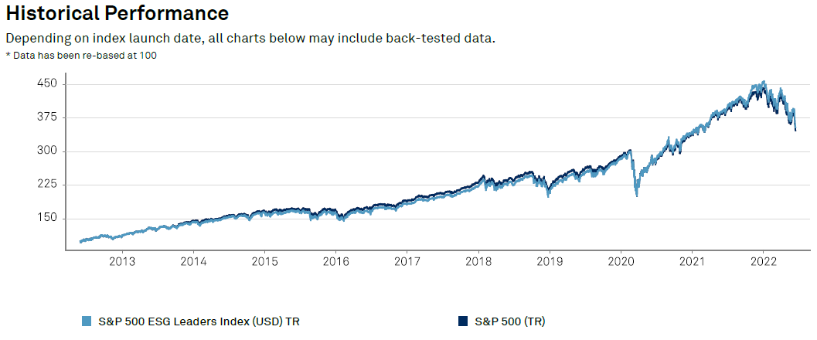
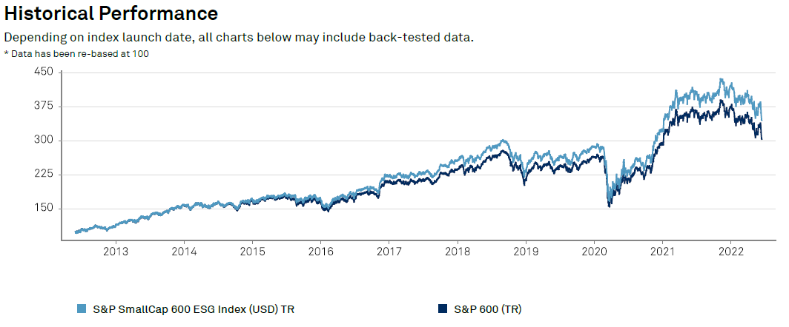
How has ESG performed?
S&P 500 ESG Leaders, S&P500, S&P SmallCap 600 ESG & S&P 600 are unmanaged indices which cannot be invested into directly. Unmanaged index returns do not reflect fees, expenses, or sales charges. Index performance is not indicative of the performance of any investment. Past performance is no guarantee of future results. More information can be found at https://www.spglobal.com/spdji/en/indices/esg/sp-500-esg-index/#overview & https://www.spglobal.com/spdji/en/indices/esg/sp-smallcap-600-esg-index/#overview
Notes:
Finally, when I bring ESG investing up to clients, the first question is often: “Yeah, that all sounds wonderful, but how does it perform?”. It is an important question for most investors who want to do good, but also want to be able to achieve their financial goals.
While past performance is never a guarantee of future returns, I wanted to show you a few indices to show you that people who invested in ESG 10 years ago have generally seen returns similar to their non-ESG peers. In these charts you can see the difference in return over the last 10 years between the S&P 500 ESG Leaders Index and the full S&P index is negligible. Over that same timeframe, the S&P SmallCap 600 ESG index has slightly outperformed the S&P 600 index.
Again, I’m not here to tell you that you will always do better financially by investing in ESG funds, but I do want to offer than in the past, people that have gone the ESG route have achieved reasonable risk adjusted returns.

Slide 16
Most Important Takeaways
Save Early
Get a Health Care Proxy and Durable Power of Attorney
Permanent and Emergency Guardians for Children
Stockpile cash before a home purchase
You can finance an education, but not retirement
Take your employer match
Pay down your highest interest rate first
Plan for the worst
Write down your goal
Understand what you are paying and who you are paying it to
Buy low and sell high
If you don’t understand it, don’t invest
Notes:
Begin saving early, wealth is accumulated through superior savings, not superior investment return.
When you turn 18, you should get a durable power of attorney and health care proxy
When you have a child, name permanent guardians in your will and get an emergency guardian document.
No one ever bought a house or had a child and said ‘I had too much in my cash reserves”. Plan accordingly.
Your children can take out loans for education and have a lifetime to pay them back. You cannot take out loans for retirement and your payback time is much shorter.
If your employer offers a match in their retirement plan, take it, it’s free money.
Dedicate most of your available funds to your highest interest rate debt, unless its tax-adjusted rate is lower than what you expect to earn while investing.
You are not invincible. You should plan for an unexpected death or disability. Bad things happen to good people and they often happen unexpectedly.
Write down your financial goals.
Fees in investments are not necessarily bad. Paying a fee and not getting value is.
You aren’t insulting a financial professional by asking how they are compensated, it should be expected.
Buy low and sell high. Don’t let your emotions make your investing decisions.
If you don’t understand it, don’t invest your money in it

Slide 17

Getting Started With Responsible Investing
    Talk with your financial advisor about:
      Aligning your portfolio with your goals and values
      Understanding the role Responsible Investing can play in your long-term financial plans
      Building a portfolio with Responsible Investments
      Comment Card
      Public Speaking
      Free Consultation
https://forms.gle/MY2QMLYMPEsMWQaF6
Notes:
Today, we discussed why RI matters, what trends you should know about, and what to think about when choosing a responsible investment manager. Responsible Investing is here to stay, and with more investments than ever to choose from, you can build a portfolio that meets your needs and reflects your values.
I can help you get started with RI. Be sure to consider your investment goals and values. You need to ask yourself what you want to achieve and the role Responsible Investing can play in your long-term financial plans.
Keep in mind that some investors go “all in” with RI while others prefer to focus on a particular theme or asset class. Some prefer an actively managed approach while others choose a responsible index fund.
When evaluating investment managers, keep in mind that no two approaches to RI are the same, and not every RI manager offers the same resources and capabilities. Choose the one that you believe gives you the best opportunity to deliver superior long-term performance while achieving positive impact.
I’m now passing around a comment card. I’d ask that you please fill this out to give me some feedback on how I did today.
I love speaking to groups like this, so if you are part of a group you’d like me to speak to, please indicate that on the comment card
Finally, if you’d like to speak with me one on one, if you have some more specific questions you’d like me to answer, please indicate that on the comment card as well.
Thank you and have a great night!

Slide 18
The returns from socially responsible investing may be lower than if the adviser made decisions based solely on investment considerations. Content in this material is for general information only and not intended to provide specific advice or recommendations for any individual. All performance referenced is historical and is no guarantee of future results. All indices are unmanaged and may not be invested into directly. No strategy assures success or protects against loss. Investing involves risk including loss of principal.
18-333 Financial planning offered through Northeast Planning Associates, Inc. (NPA), a registered investment adviser (RIA). Securities and advisory services offered through LPL Financial (LPL), an RIA and broker-dealer (BD), member FINRA/SIPC. Credit union is not an RIA or BD. Insurance products offered through LPL or its licensed affiliates. LPL registered representatives offer products and services using NPA. These products and services offered through NPA, LPL, or its affiliates, which are separate entities from, and not affiliates of the credit union, are:
Not Insured by NCUA or Other Government Agency | Not Credit Union Guaranteed
Not Credit Union Deposits or Obligations | May Lose Value

Slide 19
Responsible Investing
Aligning Your Financial Goals With Your Values
Northeast Planning Associates, Inc.
18-333 Financial planning offered through Northeast Planning Associates, Inc. (NPA), a registered investment adviser (RIA). Securities and advisory services offered through LPL Financial (LPL), an RIA and broker-dealer (BD), member FINRA/SIPC. Credit union is not an RIA or BD. Insurance products offered through LPL or its licensed affiliates. LPL registered representatives offer products and services using NPA. These products and services offered through NPA, LPL, or its affiliates, which are separate entities from, and not affiliates of the credit union, are:
Not Insured by NCUA or Other Government Agency | Not Credit Union Guaranteed
Not Credit Union Deposits or Obligations | May Lose Value
Notes:
Hello, my name is Mark Porter and I am a Certified Financial Planner Professional. Thank you for taking the time to watch my talk on Responsible Investing. This video was recorded in June of 2022. Please keep that in mind because tax laws change from time to time which could impact some of the information I share with you today.

