Slide 1
Basics of Taxes
Financial planning offered through Northeast Planning Associates, Inc. (NPA), a registered investment adviser (RIA). Securities and advisory services offered through LPL Financial (LPL), an RIA and broker-dealer (BD), member FINRA/SIPC. Credit union is not an RIA or BD. Insurance products offered through LPL or its licensed affiliates. LPL registered representatives offer products and services using MITFCU Investment & Retirement Planning. These products and services offered through NPA, LPL, or its affiliates, which are separate entities from, and not affiliates of the credit union, are:
Not Insured by NCUA or Other Government Agency | Not Credit Union Guaranteed
Not Credit Union Deposits or Obligations | May Lose Value

Slide 2
Who am I? How Do I Help?
Who Am I?
MIT Class of 2005
CFP® & CFA®
Independent Financial Planner
Volunteer
How Do I Help?
Financial Planning
Implementation
Notes:
Before we get started, I’d like to tell you a little bit about myself, why I am here and where I’ve got the background to tell you what I’m about to tell you.
I grew up in Canton Ohio and came out to Cambridge to attend MIT in 2002. I graduated from Sloan undergraduate in 2005 and joined a Fortune 500 financial planning firm. In 2008, I became one of the youngest people to become a CERTIFIED FINANCIAL PLANNERTM Practitioner and followed that with the CFA designation in 2011. Later in 2011, I left the larger company to start my own independent practice. In 2017, I reconnected with the MIT community by partnering my independent practice with the MITFCU to make my services available to their members.
I’ve spent a lot of time volunteering at MIT and the Boy Scouts through the years, though now most of my volunteer hours go into being a Selectman in Canton, Mass.
I work with my clients in two primary ways: Through Financial Planning and implementation. When I serve as a client’s Financial Planner, my job is to analyze their situation and give them advice to increase their chance of reaching their financial goals, such as retirement, a home purchase or funding a college education. When I help clients through implementation, I help them directly by investing their money or helping them get an insurance policy. Some of my clients use me for one of these services, but many choose both.

Slide 3
Taxes
Federal, State and Local Taxes
Income, Property and Sales Taxes
Progressive Income Tax
Special Tax Rates and Deductions
April 15th and October 15th
Ways to File
Paper
Web
Tax Software
Professional
Notes:
The government in the United States raises money through taxes in many ways. The Federal government taxes your income. States and local governments may tax your income, property and purchases (sales tax). The Federal income tax is progressive, meaning that the more you earn, the higher the rate you pay. These higher rates are applied to your marginal income (meaning the next dollar you earn). The first dollar you earn is taxed at the same rate as everyone else in the country, regardless of income, however the hundred thousandth dollar or millionth dollar is taxed at a higher rate. Getting a raise and “moving up a tax bracket” doesn’t subject your entire income to the higher rate, just the extra money you earn.
Certain types of income are taxed at special rates and various expenses you incur during the year can be deducted from your income while calculating your taxes. You must file a tax return by April 15th of the following year or the tax filing deadline (unless you file an extension that allows you until October 15th), detailing your income and deductions. At this point, you must also pay any taxes that you owe and if you’ve overpaid your taxes, you receive a refund. This section will describe the basics of what you will see as you start working as well as what you may see when you have to file your first tax return.
You have many options available to file your taxes. You can print the IRS form, fill it out by hand and mail it in. You can file on irs.gov yourself. You can purchase tax software which will guide you through how to fill out the forms correctly or you can compile your data and give it to a tax preparer to organize and file your taxes for you. The option that is best for you depends on the complexity of your situation and your comfort level of doing it yourself.

Slide 4
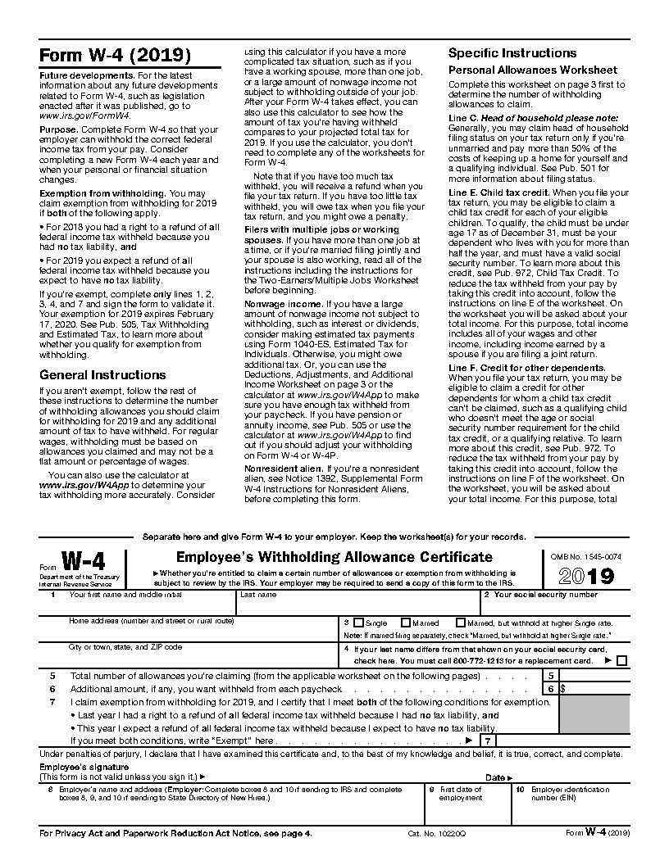
W-4 Form
Determines how much is taken out
The form will guide you to a good number
‘0’ means the most withheld
Don’t owe taxes each year
Issues from
Lumpy Paychecks
Two Jobs
Notes:
As an employee of a company, your employer is required to withhold federal income tax (among other taxes) from your paycheck. They send these taxes to the government once a quarter. The amount of taxes they withhold from your paycheck depends on the amount you earned and the number of withholdings you claim. Your withholding number is reported to your company using for W4, shown here. This form includes 3 guideline calculations for the number of withholdings you should claim. These guidelines are helpful in determining the right number, however you are legally allowed to claim whatever number you choose. Often, those starting their first job will likely claim 0 or 1 unless they have substantial student loan interest that they can deduct.
The lower the number (0 is the lowest) the more in taxes will be withheld from each paycheck. The higher the number, the less in taxes. If you find that for several years your receive a tax refund, that means you are having them withhold too much and you should consider increasing the number of withholdings. If you end up owing taxes, you should consider reducing the number of withholdings. If you owe too much in taxes or for too many years, you will pay the IRS additional interest and penalties, so it is not a wise decision to claim a high withholding number and simply try to pay your taxes at the end of the year.
If your paychecks vary in amount from period to period, this may cause as issue with your withholdings. Each paycheck is withheld as if you earn that amount each pay cycle. Because the tax system is progressive, that means that larger paychecks are withheld at a higher rate. This explains why paycheck which includes a large bonus or commission will have so much withheld, it is assumed you get that paycheck every pay period. Because your withholdings can be changed throughout the year, you may consider increasing your withholding number before a large paycheck.
Finally, if you work two jobs, this can also cause an issue with withholdings. Each job does not know about the other job, so each check may not withhold enough from each check. The W4 worksheet has a section to assist with this issue, but in general, those with two or more jobs should claim a lower withholding number than they would if they had one job.

Slide 5
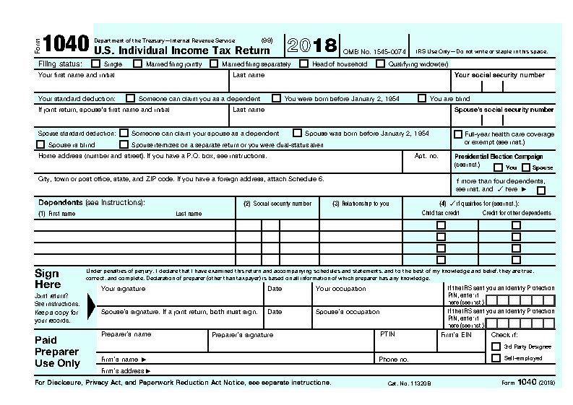
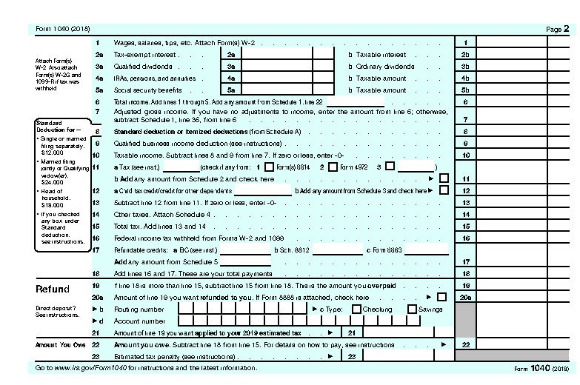
Form 1040
1040
2 Pages
Schedules 1 – 6
Schedules A - E
State Returns
Notes:
When you file your taxes, you must list your income and deductions on government issued tax forms. Following the tax changes in 2018, everyone files a 1040, there is no more 1040A or EZ
The 1040 is only 2 pages but there are many Schedules that may be attached to the form, including schedules for itemized deductions, business ownership and rental properties.
The form starts with the same personal information on page 1 and moves to your income and deductions on page 2. All of these income and adjustment totals still lead to your adjusted gross income.
The most significant addition to the 1040 is the Schedule A for itemized deductions. If your itemized deductions are more than the standard deduction, can claim this higher number instead. The most common items used on the standard deduction include mortgage interest and points, state taxes paid, property taxes paid, loss from theft and charitable contributions. While medical expenses are listed here, it should be noted that only expenses in excess of 10% of your adjusted gross income can be counted.
Those who need to file 1040 are probably best using tax software on their own or a tax preparer. The complexity of adding multiple forms and schedules, and knowing what to use and what not to use can create significant complexity and opportunities for mistakes.
Don’t forget, many states impose state income taxes, so you may have to file similar tax forms each year with your state of residence and any states you do substantial work in.

Slide 6
Info for the Self Employed/ Contract Worker
Schedule C
Additional FICA Taxes
Quarterly Payments
Deductions with good clear records
Notes:
Many people in the workforce do not work simply as employees. They may work for a larger company under a contract or they may work for themselves all together. Contract workers are issued a Form 1099 from the company they contract with as opposed to the W2 that an employee receives. Someone running their own business must simply report all the payments they receive. In either case, these individuals are considered self-employed.
If these individuals are recognized by the IRS as a Sole Proprietorship (as opposed to a partnership, S Corporation or C Corporation) they must file a Schedule C with their Form 1040. Unless you have taken specific steps to be recognized differently, the IRS will recognize you as a Sole Proprietorship. The Schedule C details the income sources for the business as well as the expenses taken against that income. The total business profit is then transferred to the first page of the 1040.
From a tax standpoint, being self-employed has many advantages and disadvantages over being an employee. The largest disadvantage centers around withholdings and Social Security and Medicare taxes (called FICA taxes). As of this writing, each employee pays 6.2% of their wages to Social Security, up to a maximum wage of around $128,400. They also pay 1.45% of their wage, with no maximum for Medicare. Their employer is also required to pay 6.2% and 1.45% on their behalf. Self-employed individuals are considered both the employer and the employee and therefore must pay both taxes on their wages.
A W2 employee has taxes automatically withheld from each paycheck and sent to the IRS. This means when they file their tax return, they’ve already paid in a substantial amount of taxes and they will usually end up with a small bill or a small refund. Self-employed individuals have no withholding and typically send payment to the IRS quarterly. The amount they pay is estimated based on the amount owed last year and includes both income taxes and both the employer an employee share of the FICA taxes. If a self-employed individual has a very successful year, they may find that the estimated taxes paid were too low and they may owe a substantial tax bill at the same time that their first estimated tax bill is due for the following year (April 15th). It is a very good idea to keep track of the profitability of a business over the year to ensure enough money is set aside to pay the taxes due.
Self-employed individuals do receive benefits that employees do not. Self-employed individuals can write off business expenses against their income which lowers their taxes due. Some common deductions available include deductions for a home office, business use of a vehicle, phone and internet fees, capital items such as computers, desks and phones and other expenses essential to run a business. The IRS is very strict about being able to prove that deductions are legitimate. Care should be taken to keep separate accounts for personal and business expenses and to keep receipts and logs to justify business expenses. A self-employed person can also receive deductions for the “employer” portion of the FICA taxes and health insurance on the front of their Form 1040.
Managing and preparing the taxes for the self-employed can be a job in itself. Clear and distinct records and logs are essential to easy tax preparation and to stay compliant with the law. While many W2 employees can function very well by preparing their own taxes by hand or with the help of online software, most business owners should hire an accountant to help them prepare their tax returns and to make sure they are taking steps to be compliant with the law.

Slide 7
Gift and Estate Taxes
Estate Taxes are paid upon death
Total of all assets and life insurance
Changing Exemption of $11.18M
Gifts over $15k carry same implications
Proper planning can reduce taxes owed
The recipient of a gift or inheritance never pays taxes
Rules are different for non-citizens
Notes:
In addition to collecting taxes on income, the United States collects taxes upon the total value of your estate upon your death, provided the total value is over a certain threshold. Your estate includes all of your assets, including real estate as well as the death benefits of any life insurance policies. This area is subject to constant and changing legislation so information discussed here should be reviewed for timeliness before any specific planning decisions are made.
Most Americans will never have to pay a federal estate tax. First, a married couple of US citizens can pass an unlimited amount to each other in their lifetime or at death with no taxes due. This is one reason that financially, federal recognition of same sex marriage was so significant. Transfers at death to a non-spouse are subject to a federal estate tax if the total transferred to non-spouses is over approximately $11,180,000 at the time of this writing. If the tax threshold is reached, the tax rate can be staggering, approaching 40%.
There are many legal ways to reduce an estate tax burden but the specifics of most strategies are beyond the scope of this book. When someone begins to approach this level of assets, they should initiate a conversation with an estate planning attorney.
One common and simple way to reduce a taxable estate and in some cases protect your money from nursing home costs, is to simply give your money away. Gifts to qualified charities carry no limit and can result in an income tax deduction for the giver. Payments made directly for medical care or for higher education for anyone are also exempt from any taxes or reporting, however they must be paid directly to the institution. Additionally, contributions to some types of education plans (14B) allow you to make 5 years of contributions at once, rather than spreading them out.
Any other type of gifts to a non-spouse come with several rules. First, at the time of this writing, any one person can give another person $15,000 per year with no tax consequences or reporting requirements. This limit is called your annual exclusion. For example, one married couple could give $60,000 per year to another married couple (4 multiplied by $15,000). If this threshold is exceeded, even by $1, a gift tax return must be filed by the person that gives the gift. Even though this tax form must be filed, a tax bill may not be due. Before taxes must be paid, any gift is deducted from the approximately $11,180,000 exemption discussed earlier, reducing it at the time of death. However, as long as part of the exemption remains, no taxes will be due.
Under current legislation, very few Americans will ever deal with an estate tax issue. Some States have lower limits and care should be taken to review the limit in the state you reside. If you find yourself approaching the limit, you should consult with a qualified estate planning attorney. Special situations also exist of one or more individuals is not a US citizen. These issues should also be brought to a qualified estate planning attorney, even if an estate is well below the current threshold.
Finally, at some point in your life you may receive a generous gift from a friend or relative. It is important to remember that in no situation is tax due from you, the person who receives the gift, only the person that gives it. The gift recipient has no obligation (or form to file) to report the gift.

Slide 8
2018 Tax Bill
For many, taxable income increases but the rate applied to that income goes down
More people will take the Standard Deduction ($12k/$24k)
Taxable Income Increases
Limited SALT to $10k
Limits on Mortgage Interest
Eliminates Personal Exemption
Rate may go down
2017 Brackets: 10%, 15%, 25%, 28%, 33%, 35%, 39.6%
2018 Brackets: 10%, 12%, 22%, 24%, 32%, 35%, 37%
Notes:
This presentation was prepared well before the tax changes that were voted on in December 2017, so I added this slide to give you a few ideas, but discussing the changes could be their own presentation.
First and foremost, nothing changes for 2017 and you will file your taxes this year as you would in the past.
The biggest take-away from what I have seen for 2018, is that for many people, their taxable income will increase but the rate applied to this income will decrease.
Taxable Income, remember, is your income after retirement contributions and deductions.
Also, people have always had the choice to take the standard deduction or itemize on Schedule A. With the increase in the standard deduction and limitation on some itemized deduction, more people will likely itemize.
Why might your taxable income go up? Well, if you have a house and work her in Massachusetts, you pay property taxes and a Mass income tax. Moving forward, the most you can take between these two is $10k.
If you had a home equity line of credit or loan, that interest is no longer deductible, and in the future, if you were to purchase a home with more than a $750k mortgage, only the first $750k of the loan interest will be deductible.
Finally, we all got to take about a $4k personal exemption on our taxes, but that has been eliminated.
The good news, is that the tax brackets have been reduced, which means that even if your taxable income is higher, since the rate applied is lower, you may not end up paying more.
Of course, the best way to know for sure is to speak with your tax advisor. I recommend everyone set aside a little extra time in their meeting with that tax person to discuss the changes.

Slide 9
Most Important Take Aways
Save Early
Get a Health Care Proxy and Durable Power of Attorney
Permanent and Emergency Guardians for Children
Stockpile cash before a home purchase
You can finance an education, but not retirement
Take your employer match
Pay down your highest interest rate first
Plan for the worst
Write down your goal
Understand what you are paying and who you are paying it to
Buy low and sell high
If you don’t understand it, don’t invest
Notes:
Begin saving early, wealth is accumulated through superior savings, not superior investment return.
When you turn 18, you should get a durable power of attorney and health care proxy
When you have a child, name permanent guardians in your will and get an emergency guardian document.
No one ever bought a house or had a child and said ‘I had too much in my cash reserves”. Plan accordingly.
Your children can take out loans for education and have a lifetime to pay them back. You cannot take out loans for retirement and your payback time is much shorter.
If your employer offers a match in their retirement plan, take it, it’s free money.
Dedicate most of your available funds to your highest interest rate debt, unless its tax-adjusted rate is lower than what you expect to earn while investing.
You are not invincible. You should plan for an unexpected death or disability. Bad things happen to good people and they often happen unexpectedly.
Write down your financial goals.
Fees in investments are not necessarily bad. Paying a fee and not getting value is.
You aren’t insulting a financial professional by asking how they are compensated, it should be expected.
Buy low and sell high. Don’t let your emotions make your investing decisions.
If you don’t understand it, don’t invest your money in it

Slide 10
Wrap Up
Comment Card
Public Speaking
Free Consultation
Content in this material is for general information only and not intended to provide specific tax, legal, or investment advice or recommendations for any individual. Consult a tax advisor or attorney for your specific tax or legal situation. No strategy assures success or protects against loss. Investing involves risk including loss of principal.
Financial planning offered through Northeast Planning Associates, Inc. (NPA), a registered investment adviser (RIA). Securities and advisory services offered through LPL Financial (LPL), an RIA and broker-dealer (BD), member FINRA/SIPC. Credit union is not an RIA or BD. Insurance products offered through LPL or its licensed affiliates. LPL registered representatives offer products and services using MITFCU Investment & Retirement Planning. These products and services offered through NPA, LPL, or its affiliates, which are separate entities from, and not affiliates of the credit union, are:
Not Insured by NCUA or Other Government Agency | Not Credit Union Guaranteed
Not Credit Union Deposits or Obligations | May Lose Value
Notes:
Great, well thanks again for taking the time to come today. I’m now passing around a comment card. I’d ask that you please fill this out to give me some feedback on how I did today.
I love speaking to groups like this, so if you are part of a group you’d like me to speak to, please indicate that on the comment card
Finally, if you’d like to speak with me one on one, if you have some more specific questions you’d like me to answer, please indicate that on the comment card as well.
Thank you and have a great night!

