Slide 1

Financial Planning 101
Mark Porter, CFP, CFA
Financial Planner
MIT FCU Investment & Retirement Planning
Financial planning offered through Northeast Planning Associates, Inc. (NPA), a registered investment adviser (RIA). Securities and advisory services offered through LPL Financial (LPL), an RIA and broker-dealer (BD), member FINRA/SIPC. Credit union is not an RIA or BD. Insurance products offered through LPL or its licensed affiliates. LPL registered representatives offer products and services using MITFCU Investment & Retirement Planning. These products and services offered through NPA, LPL, or its affiliates, which are separate entities from, and not affiliates of the credit union, are:
Not Insured by NCUA or Other Government Agency | Not Credit Union Guaranteed
Not Credit Union Deposits or Obligations | May Lose Value

Slide 2

Financial Planning 101
Establish goals
Cash reserves
Debt management
Power of saving
Taxes
Knowing your financial professionals

Slide 3
Financial Planning 101
Establish goals
  Many financial decisions are based on timeframe
Efficiently allocate $$$, you need to understand your goals
  Do you want to go back to school?
  Do you want to buy a house?
  Do you want to retire early? Late?
  Do you want to pay for someone else’s education?

Slide 4
Financial Planning 101
Cash Reserves
  Most important and most overlooked aspect of financial planning
  Can be checking, savings, money market types of accounts
  Recommend a reserve of 3 – 6 months worth of expenses
  3-Tier cash reserve
  Stock market can be attractive; it does not make sense to invest if you cannot protect against emergencies and opportunities
Checking/Savings
Money Market
CDs

Slide 5
Debt Management
Student Loans
  Interest rate
  Tax deductibility
  Mortality
Credit Cards
  Building your credit
Tax Equivalent Interest
Rate * (1 – Tax Rate)

Slide 6
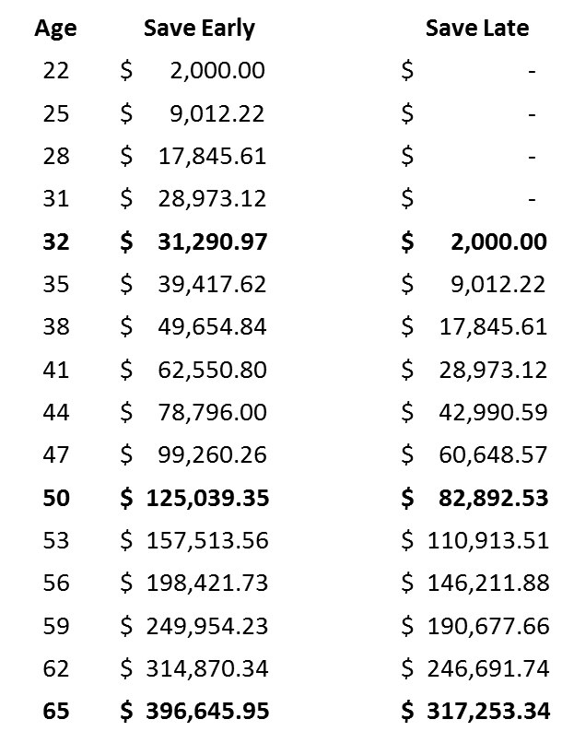
The Power of Saving
What if you save
  $2,000/year for 10 years, starting at age 22 and get an 8% rate of return?
  $2,000/year from age 32 until age 65?
    It is not easy to sacrifice lifestyle, but long term rewards can be significant
No more saving
Tax Equivalent Interest
Rate * (1 – Tax Rate)
This is a hypothetical example and is not representative of any specific investment. Your results will vary. The hypothetical rate of return used does not reflect the deduction of fees and charges inherent to investing. Investing involves risk including loss of principal.

Slide 7
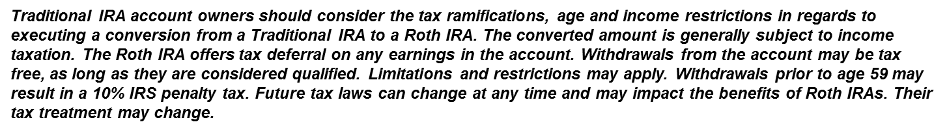
Financial Planning 101
Taxes
  Pre-Tax Vehicles
    401(k) / 403(b) / 457
    SEP / SIMPLE
  Post-Tax Vehicles
    Roth IRA / Roth 401(k)
Which is better?
Roth conversion
Withholdings

Slide 8
Financial Planning 101
Knowing your Financial Professionals
  Accountant
  Broker
  Financial planner
    Fee based?, Transaction based?, Both?
    CFP®, CFA, CRPC

Slide 9
Learn More
  Mark Porter, CFP, CFA
  Work: (781) 562-1800 / Cell: (617) 359-6191
  Email: mark.porter@lpl.com
mitfcu.org/financial-retirement
Financial planning offered through Northeast Planning Associates, Inc. (NPA), a registered investment adviser (RIA). Securities and advisory services offered through LPL Financial (LPL), an RIA and broker-dealer (BD), member FINRA/SIPC. Credit union is not an RIA or BD. Insurance products offered through LPL or its licensed affiliates. LPL registered representatives offer products and services using MITFCU Investment & Retirement Planning. These products and services offered through NPA, LPL, or its affiliates, which are separate entities from, and not affiliates of the credit union, are:
Not Insured by NCUA or Other Government Agency | Not Credit Union Guaranteed
Not Credit Union Deposits or Obligations | May Lose Value

